Slide 1
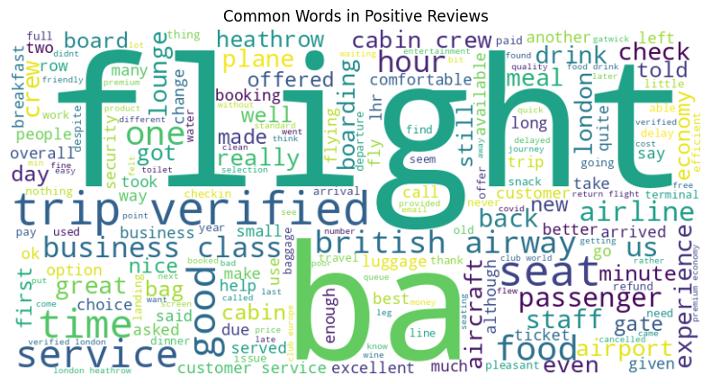
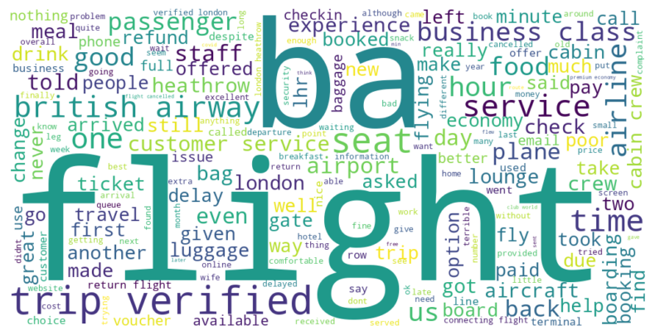
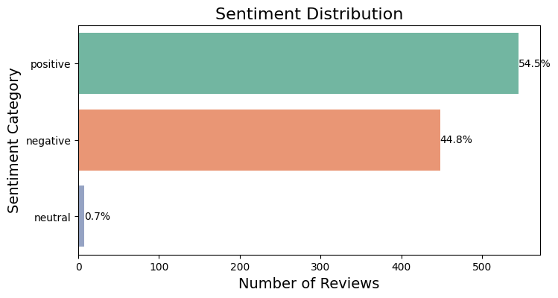
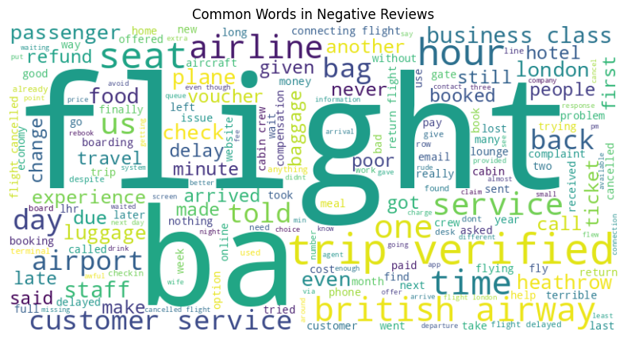
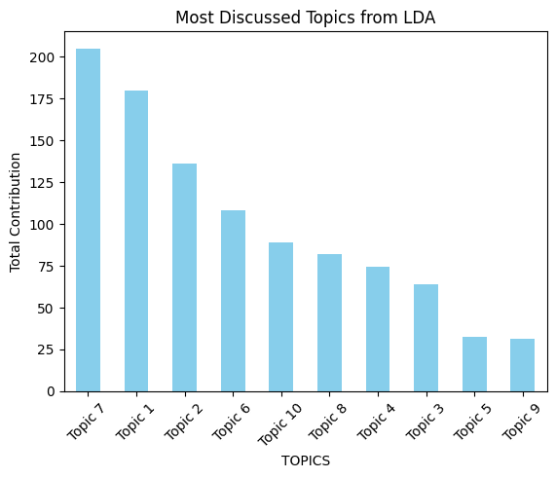
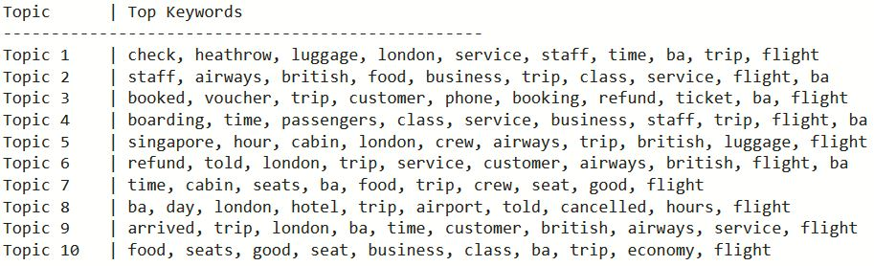
Airline Review Analysis Summary
Positive reviews about overall service, seating arrangement, food etc.
Negative experience about customer service, seating, delays, baggage issues etc.
Most Reviews discuss about things like services, seating arrangements, process and flight durations etc.
Topic 7 is most frequently mentioned. It concerns in-flight experience with British Airways. It includes positive comments regarding the comfort of the seats, the quality of food, and the service provided by the crew. Keyword [good]
[time] suggests that punctuality and scheduling are also significant aspects of passenger feedback.
Also reflected in Positive review WordCloud.

